Slide 1

Deducing Investment Opportunity for a Real Estate Investment Company
Where to invest in Queens County, New York
By: Tamjid Ahsan
Date: June 23, 2021, 05:00 PM [DST]

Slide 2

INDUSTRY OVERVIEW
New York City is among the most expensive and competitive housing markets in the USA.
It was impacted severely by the COVID-19.
NYC is a buyer's real estate market and buyers may have an opportunity to get some heavy discounts.
Many industry experts have been predicting a strong property appreciation in New York starting from 2021.
Home prices are still low compared to where they were last year, just before the pandemic hit New York City.
Most buyers aren't paying sellers' asking prices.
Since 2012, the NYC home values have appreciated by nearly 52% as per Zillow Home Value Index.
This makes New York as one of the best real estate market for homes to get into.
The house prices are relatively low
High buyer power
Huge inventory of homes
Projected uptrend in price leading to higher return on investment.
Notes:
New York City is among the most expensive and competitive housing markets in the USA. It was impacted severely by the COVID-19 with high job loss. NYC is among the top impacted areas of the country. New York has been recovering from the economic impacts of the pandemic as of mid 2021. The strong buyer demand has also changed the dynamics of the residential real estate sales market that had been cooling for nearly three years.
NYC, however, is still a buyer's real estate market and buyers may have an opportunity to get some heavy discounts.
Many industry experts have been predicting a strong property appreciation in New York starting from 2021. 2021 is should be a great year for property owners. Different business sectors have been opening up in different ways and at differing speeds with relaxing COVID-19 policies. The current trends show that the New York housing market will be hyperactive in the peak home-buying season.
Home prices are still low compared to where they were last year, just before the pandemic hit New York City. Most buyers aren't paying sellers' asking prices. In April 2021, the New York real estate market (statewide) showed strong sales due to pent-up buyer demand, according to the most recent housing report released by the New York State Association of REALTORS®. Closed and pending sales remained strong in April of 2021, marking the eighth consecutive month of sales growth in year-over-year comparisons. Since 2012, the NYC home values have appreciated by nearly 52% as per Zillow Home Value Index.
This makes New York as one of the best real estate market for homes to get into as the house prices are relatively low, high buyer power and huge inventory of homes for sale to choose from and a projected uptrend in price leading to higher return on investment.

Slide 3
BUSINESS PROBLEM
XYZ, Inc. LLC is a (read: fictional) private equity investment company based on Queens, New York.
They want to invest in the housing market for relatively short term, three years.
They want to isolate and invest in properties with the highest return on investment potential based on geographical location close to their operation base in Queens, as they want to cluster their investment based on location.
For this analysis, all 55 zip codes of Queens county of New York city, NY were considered.
This analysis will recommend top five zip codes with return-on-investment potential with some insights, which will aid the top management of the company to make an educated decision on where to invest.

Slide 4
METHODOLOGY
Zillow House Value dataset is used.
Data from January 1996 to April 2021
Monthly data
Several analysis techniques were used such as conventional time series method such as
ARIMA (autoregressive integrated moving average)
SARIMAX (ARIMA with seasonal trends)
Forecasted for three years in the future using the best model.

Slide 5

Queens County New York
OVER THE YEARS

Slide 6
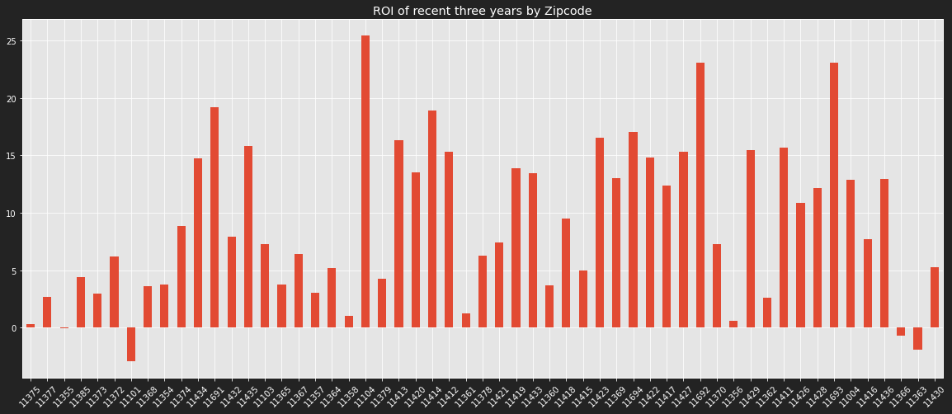
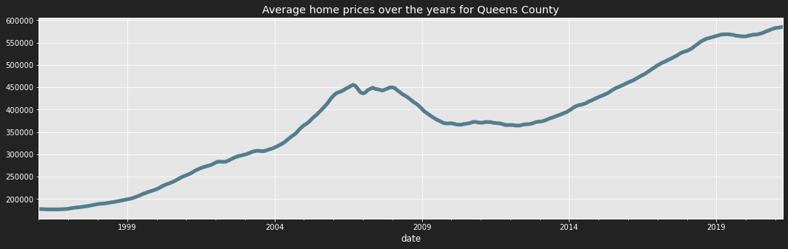
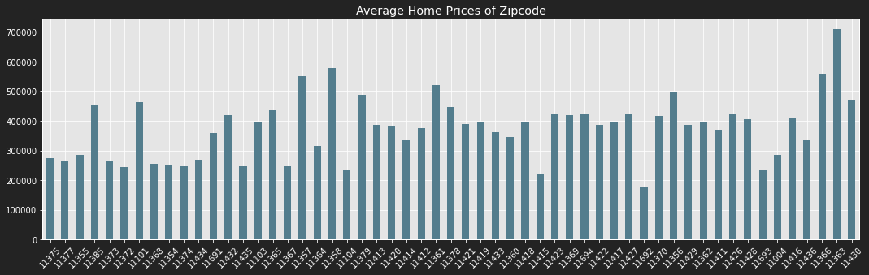
QUEENS COUNTY OVERVIEW
ROI is negative for only a few of the zip codes
11101
11436
11366
Enjoying a recent bull run.
Recovered well beyond the financial crisis of 2009
Average median value is well above 200k across zip codes.

Slide 7
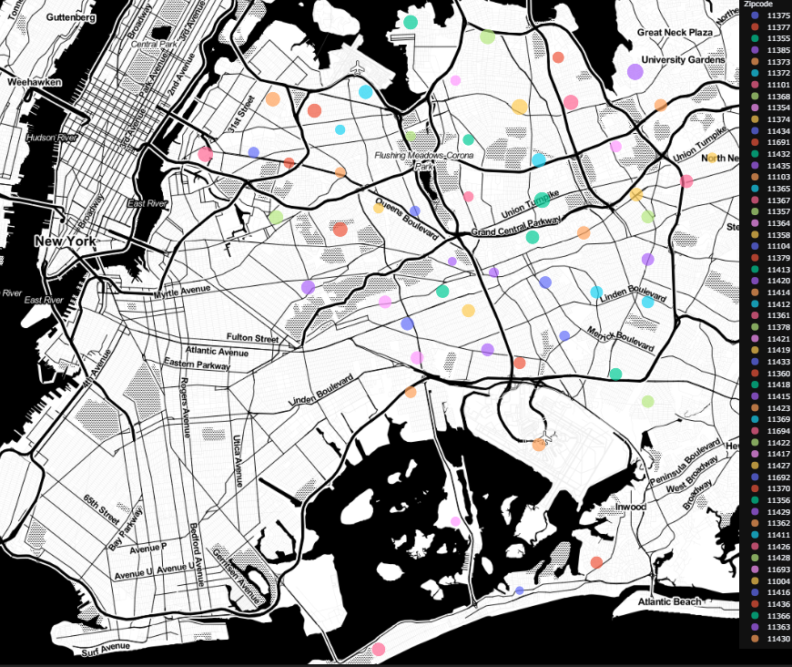
BEST INVESTMENT BY ZIP CODE

Slide 8
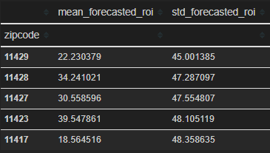
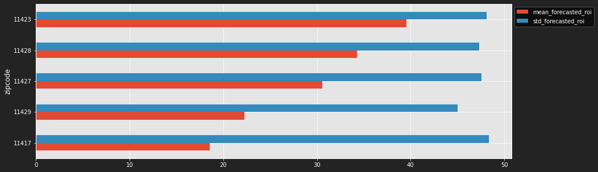
SELECTION CRITERIA
Risk:
Cost is assumed to be the last true value of the median price of the zip code, i.e., value on April 30, 2021.
revenue is assumed to the mean forecasted value after three years, i.e., 36 steps in the future.
Then standard deviation is taken of the return on investment on upper confidence level and lower confidence level respectively as a proxy of risk of investment.
Top five zip codes based on best 15 (27% of all available investment opportunity) ROI and then selecting top 5 of the based on lowest risk, i.e., the risk proxy mentioned above.

Slide 9
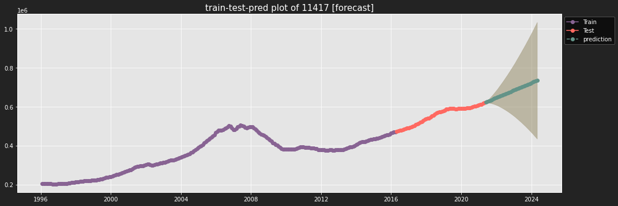
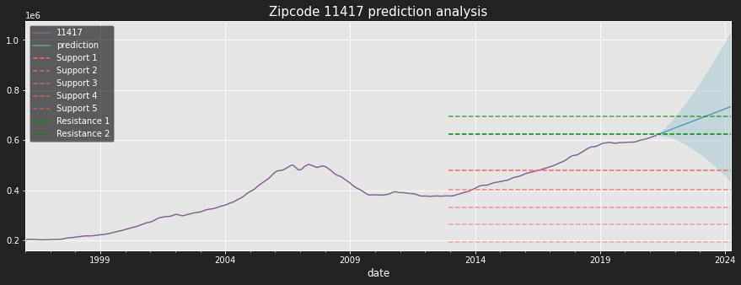
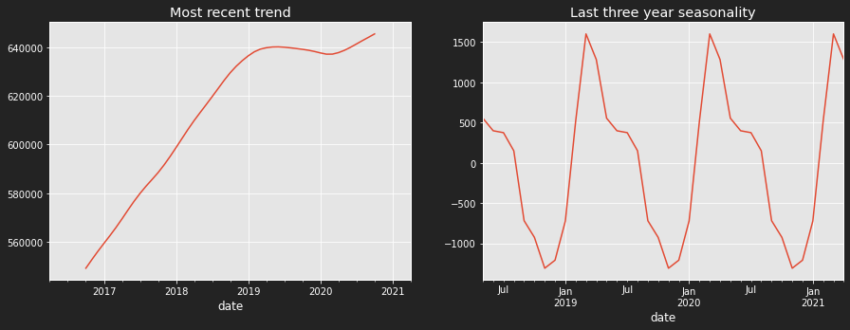
11417
Observation:
Massive uptrend since 2017
Got struck by COVID19
Recently breached three-year resistance, expected to keep the uptrend.
Huge ROI potential.

Slide 10
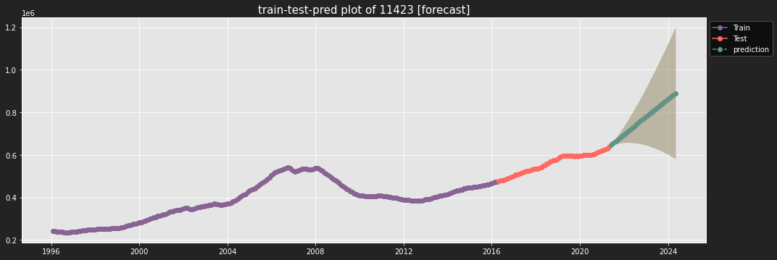
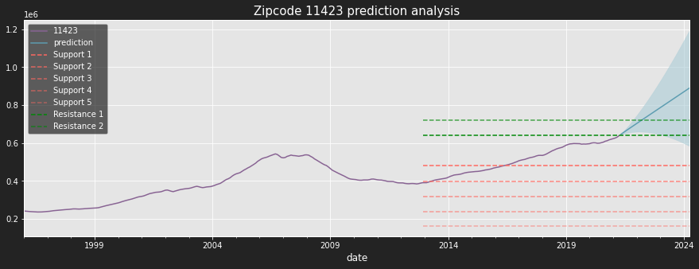
11423
Observation:
Massive uptrend since 2017
Got struck by COVID19
Recently breached three-year resistance, expected to keep the uptrend.
Huge ROI potential.

Slide 11
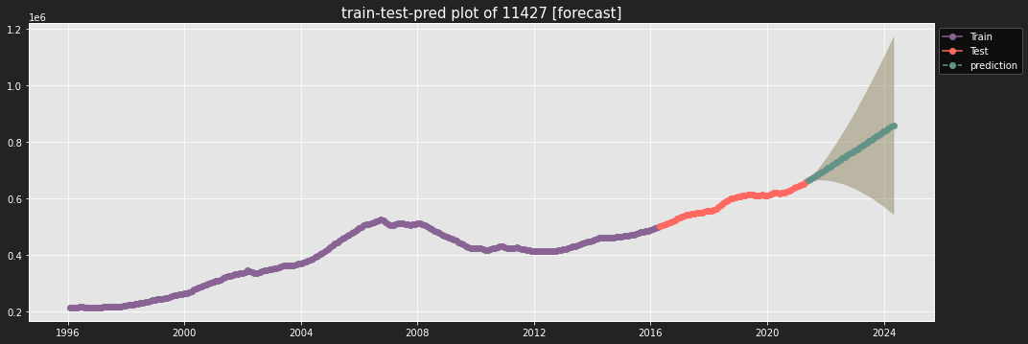

11427
Observation:
Massive uptrend since 2017
Got struck by COVID19
Recently breached three-year resistance, expected to keep the uptrend.
Huge ROI potential.

Slide 12


11428
Observation:
Massive uptrend since 2017
Got struck by COVID19
Recently breached three-year resistance, expected to keep the uptrend.
Huge ROI potential.

Slide 13


11429
Observation:
Massive uptrend since 2017
Got struck by COVID19
Recently breached three-year resistance, expected to keep the uptrend.
Huge ROI potential.

Slide 14
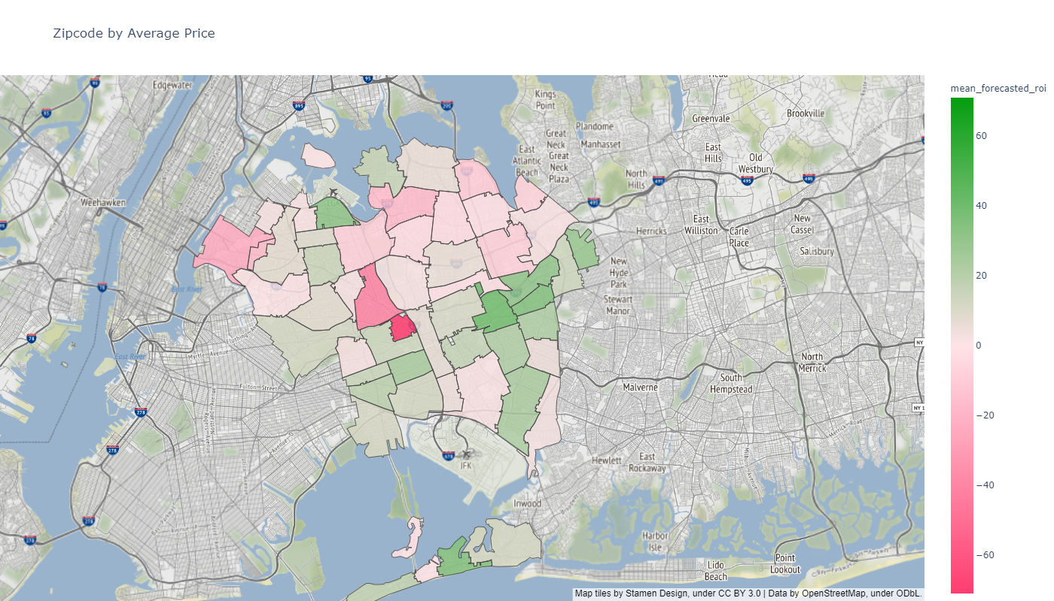
ON A MAP

Slide 15
SUMMARY
Invest in properties in these zip codes.

Slide 16
RECOMMENDATION
Invest in following zip codes:
11429
11428
11427
11423
11417
Stay away from these, they are in a bubble :
11693
11415
Rule of thumb
Go to southeast part of Queens for good investment opportunity.
Some of the house are overvalued, and awaits correction, be careful of those houses.

Slide 17

NEXT STEPS
Add variables to model, using a SARIMAX model
Interest rate
Other qualitative indicators of house value based on location, e.G., Schools.
Buyer and seller ratio
Try other machine learning models

Slide 18
THANK YOU
GitHub: @tamjid-ahsan
LinkedIn: linkedin.com/in/tamjidahsan/
Project repo: https://github.com/tamjid-ahsan/dsc-phase-3-project

Slide 19
APPENDIX

Slide 20
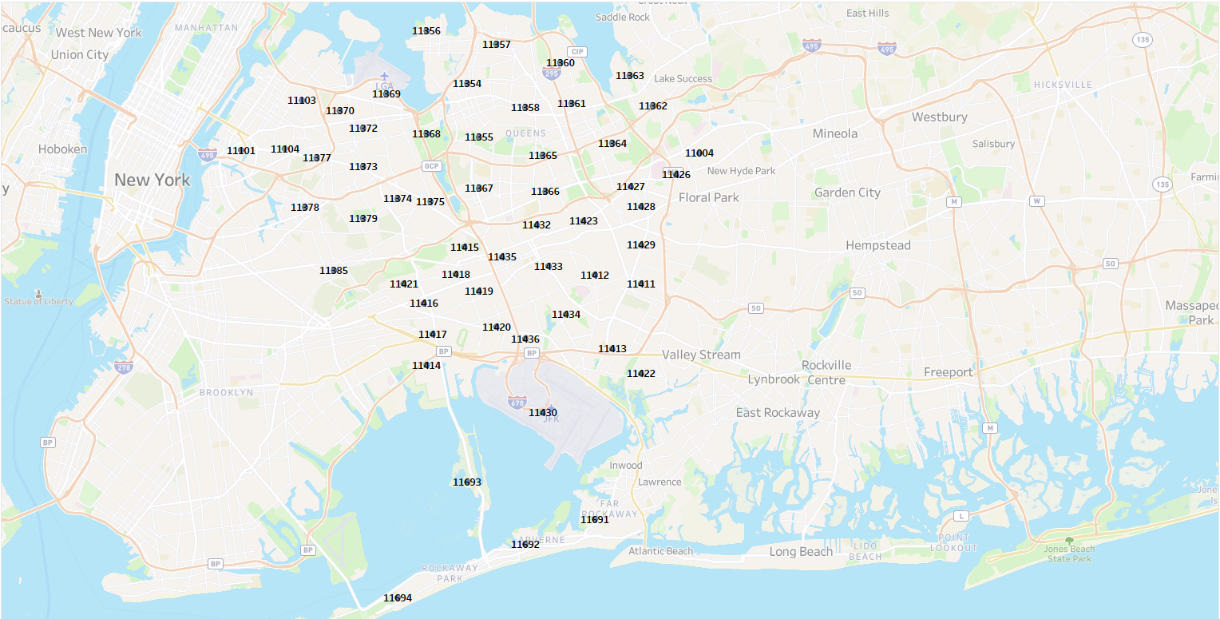
ZIP CODE Location

